Slide 1





HCI project 6 prototype demo
Personal Tour Assistant
22CST Yusi (蒋云翔)
Thursday, December 26, 2024

Slide 2





01
Home page

Slide 3
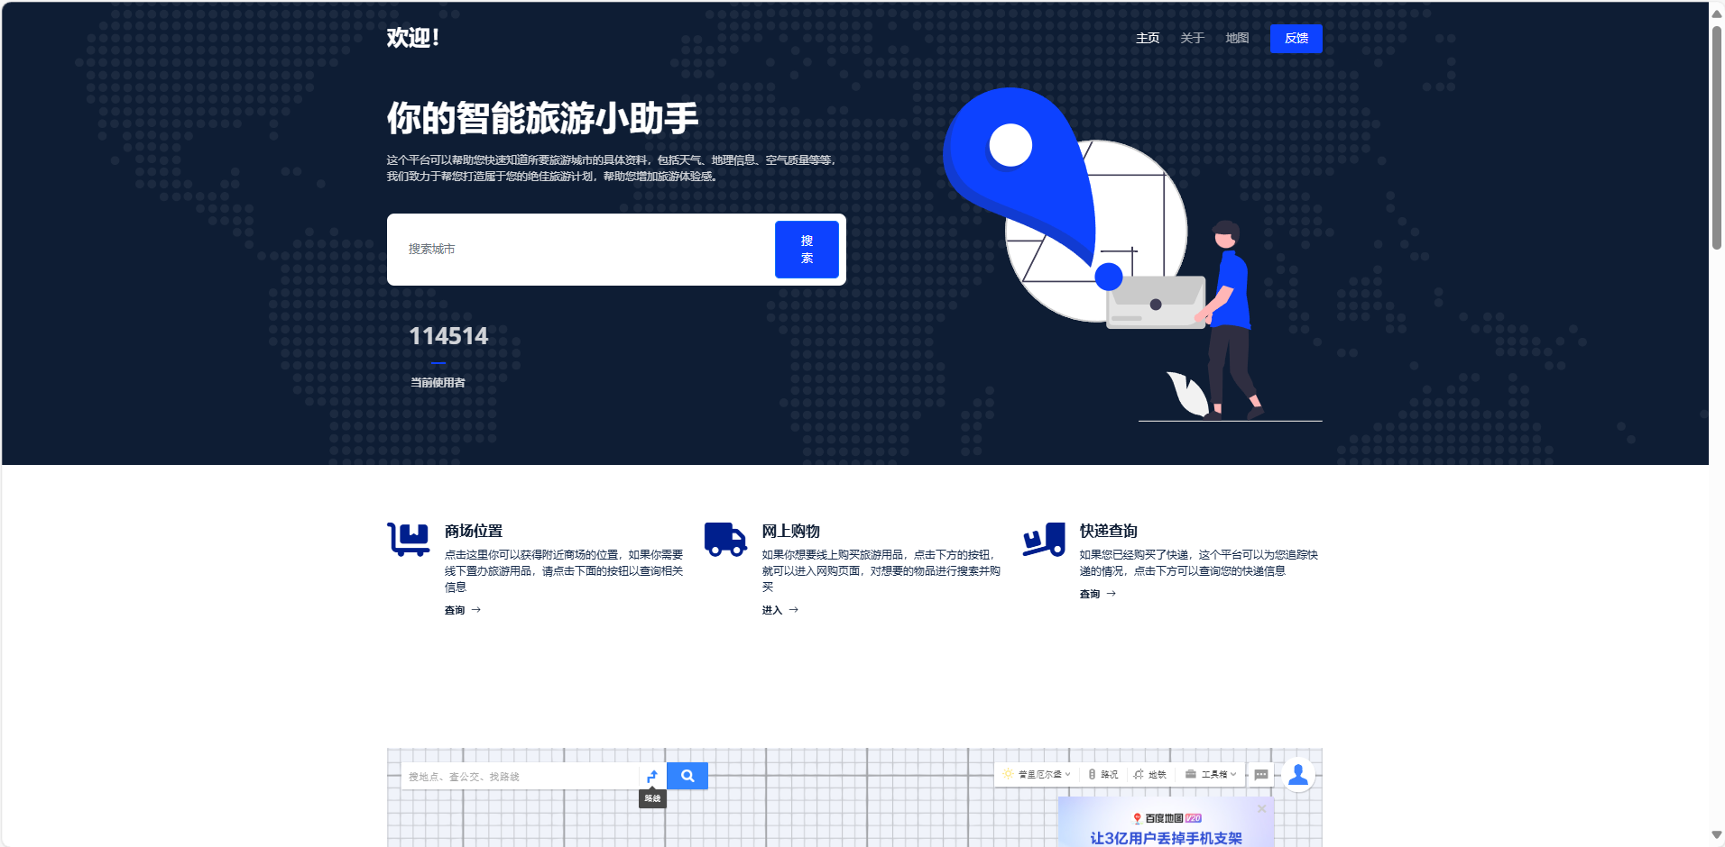
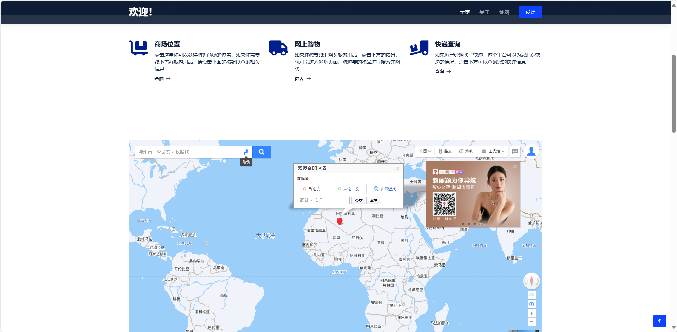
Home page

Slide 4
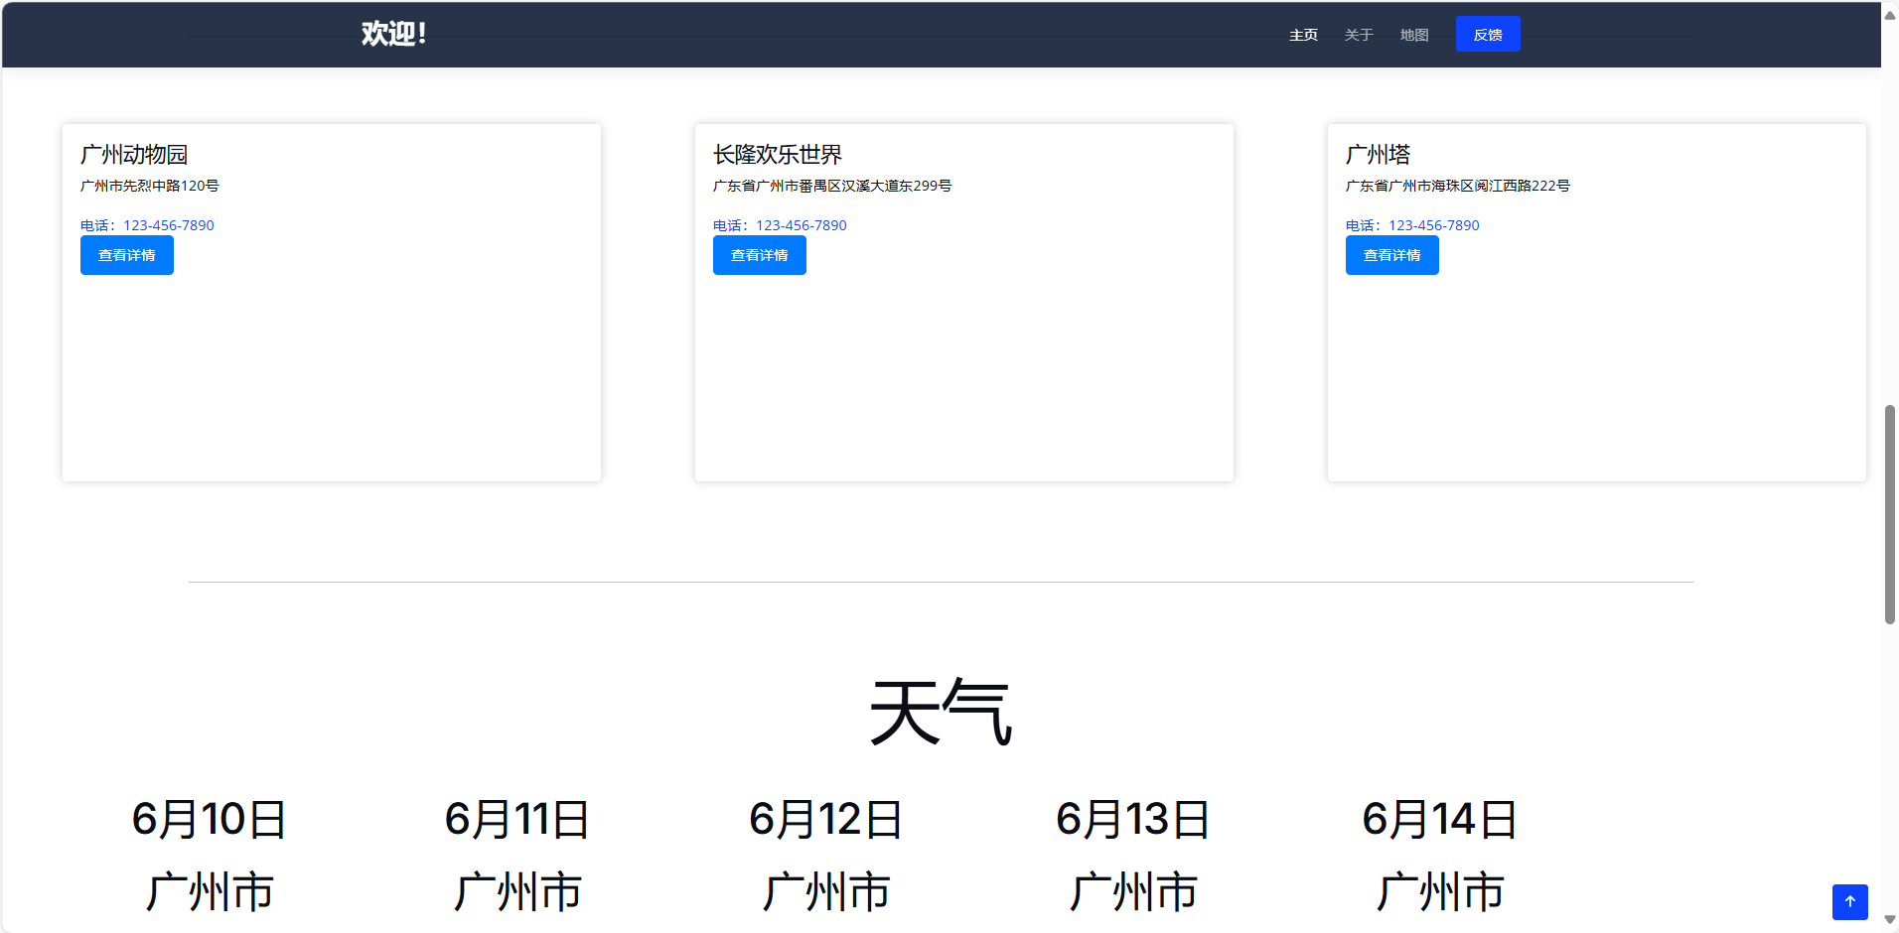
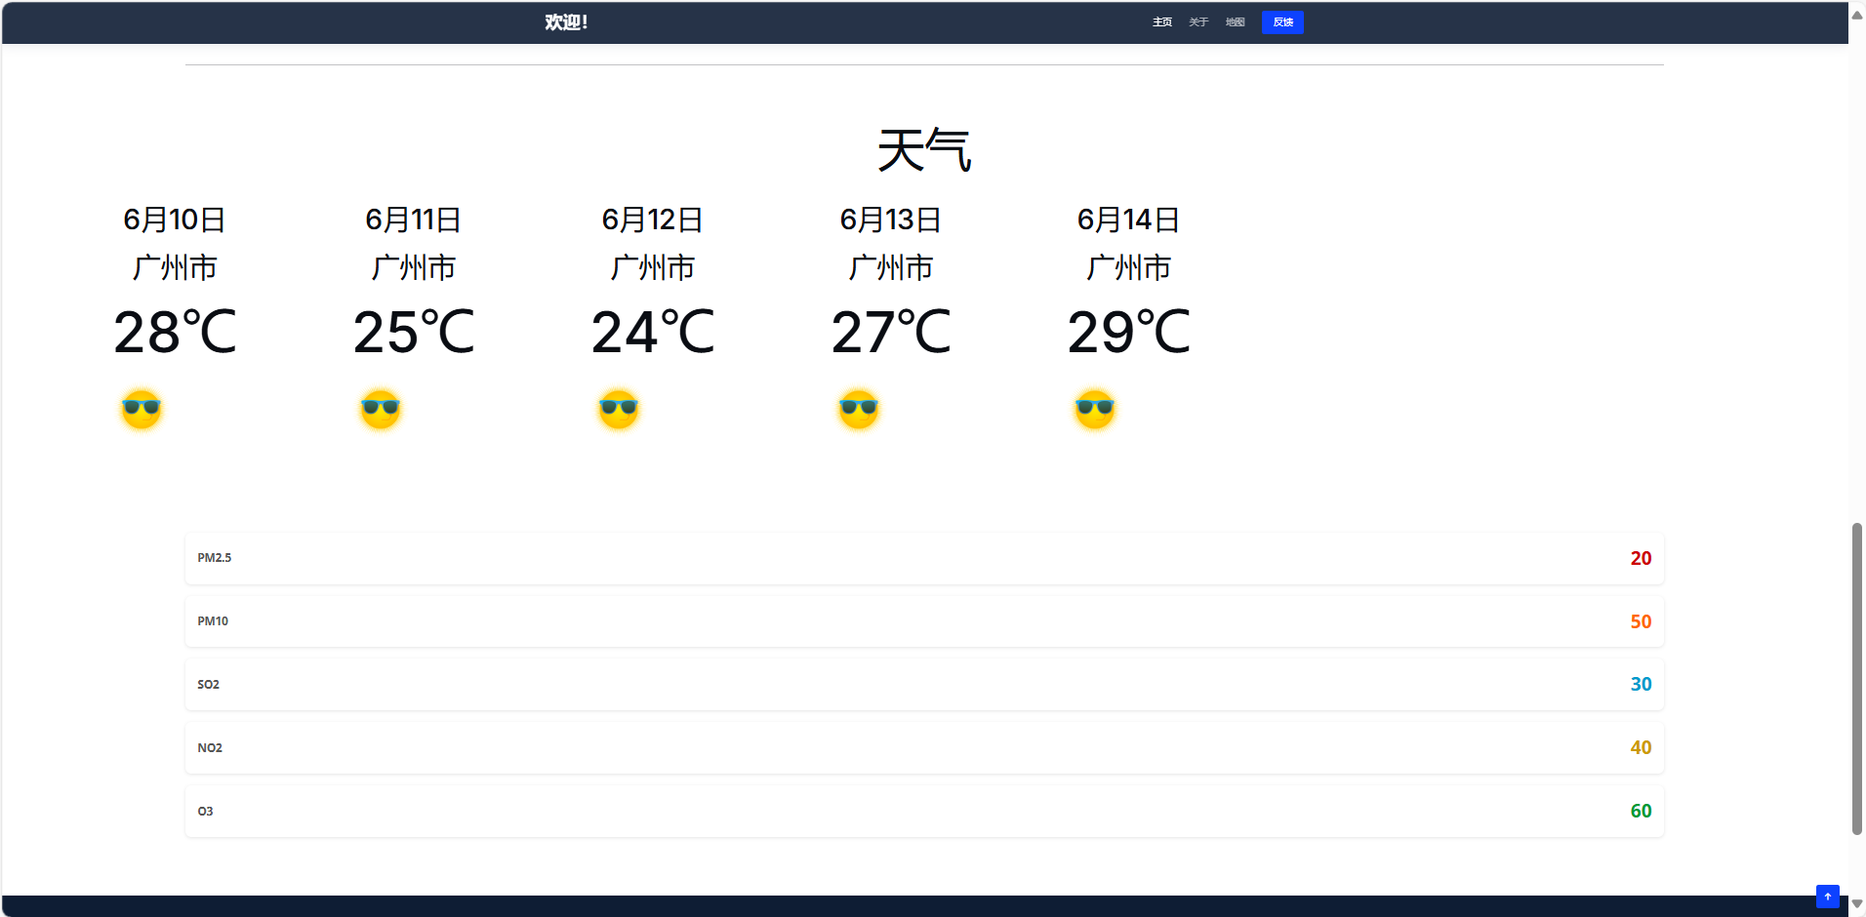
Home page

Slide 5
Home page

Slide 6
02
About us

Slide 7
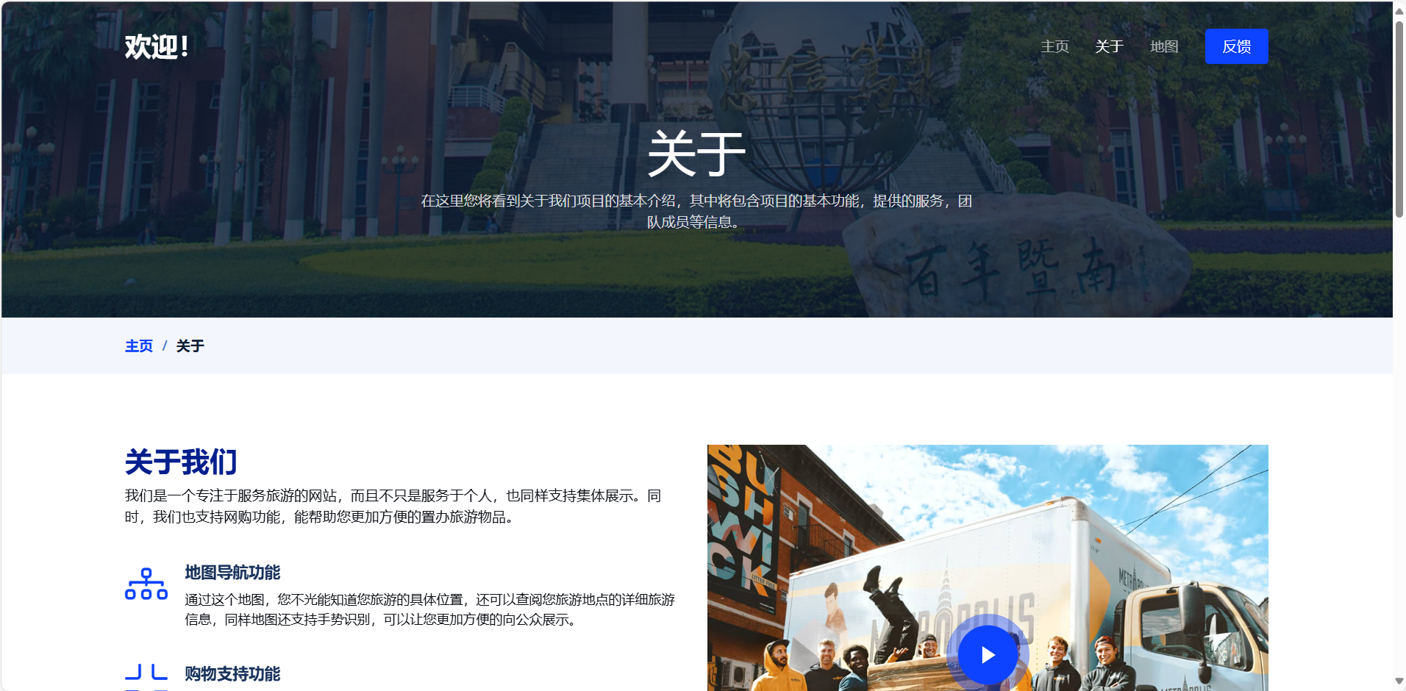
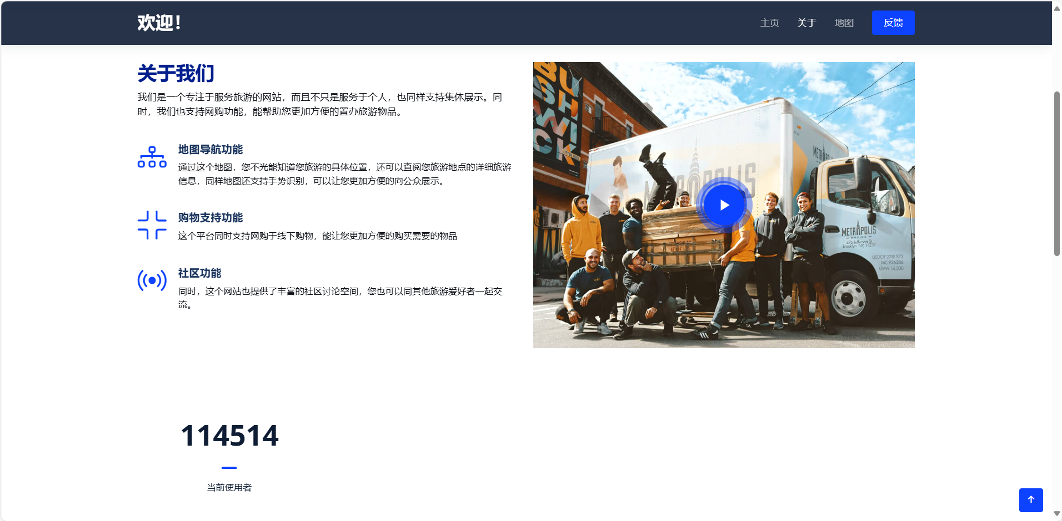
About us

Slide 8
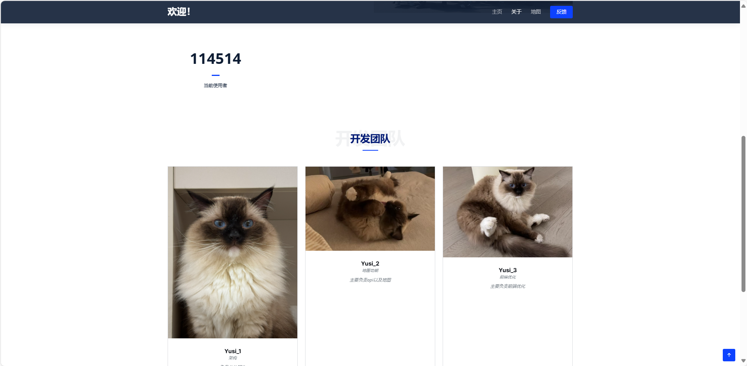
About us

Slide 9
03
Contact

Slide 10
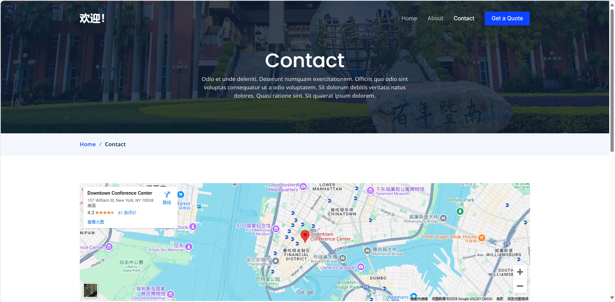
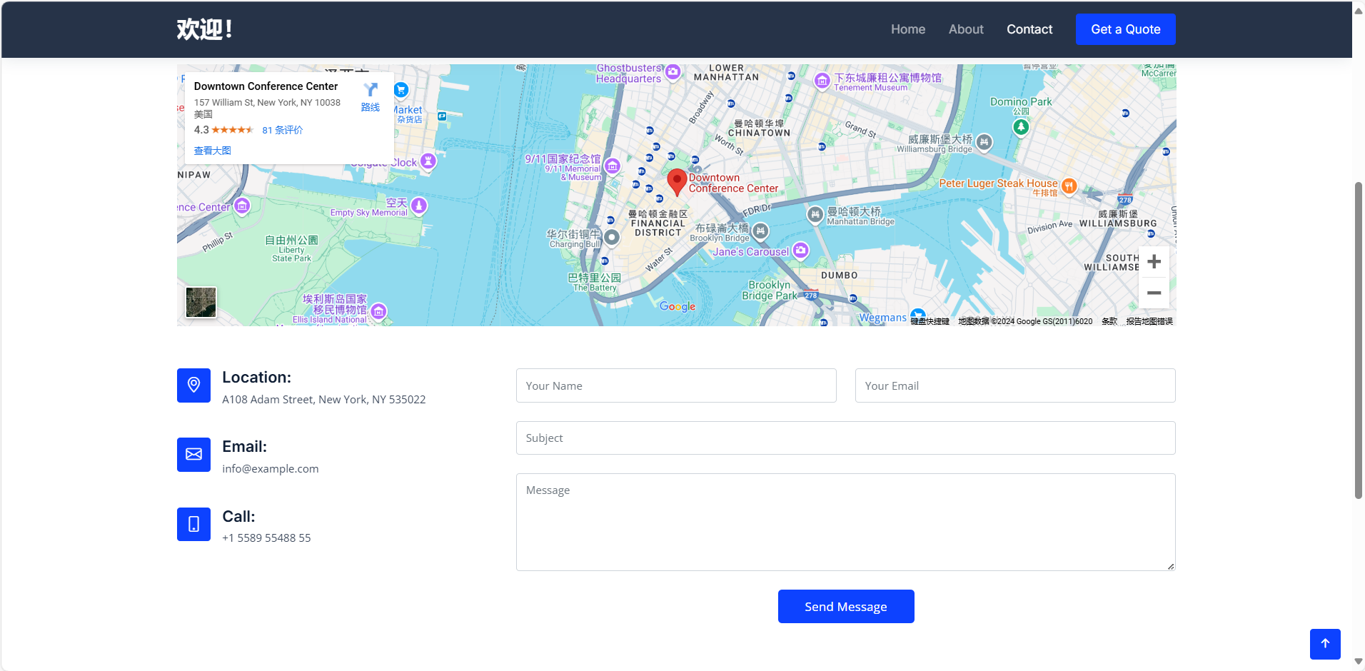
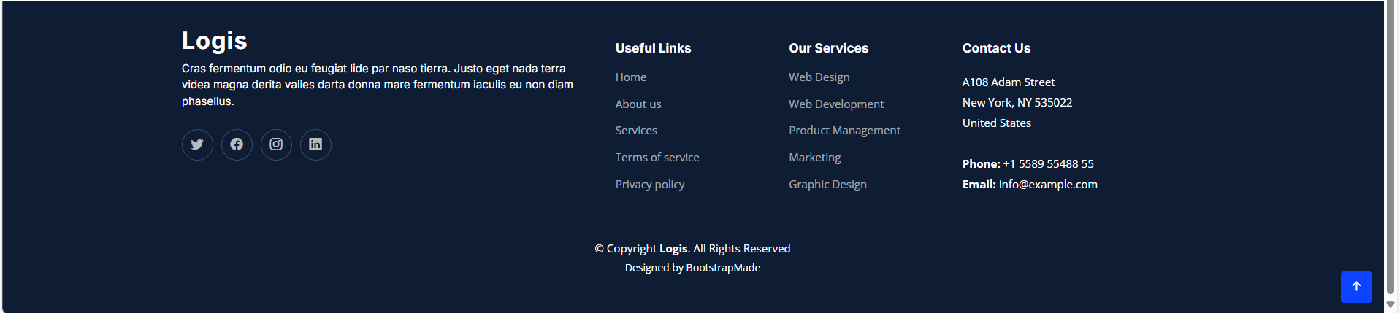
Contact

Slide 11
04
Feedback

Slide 12
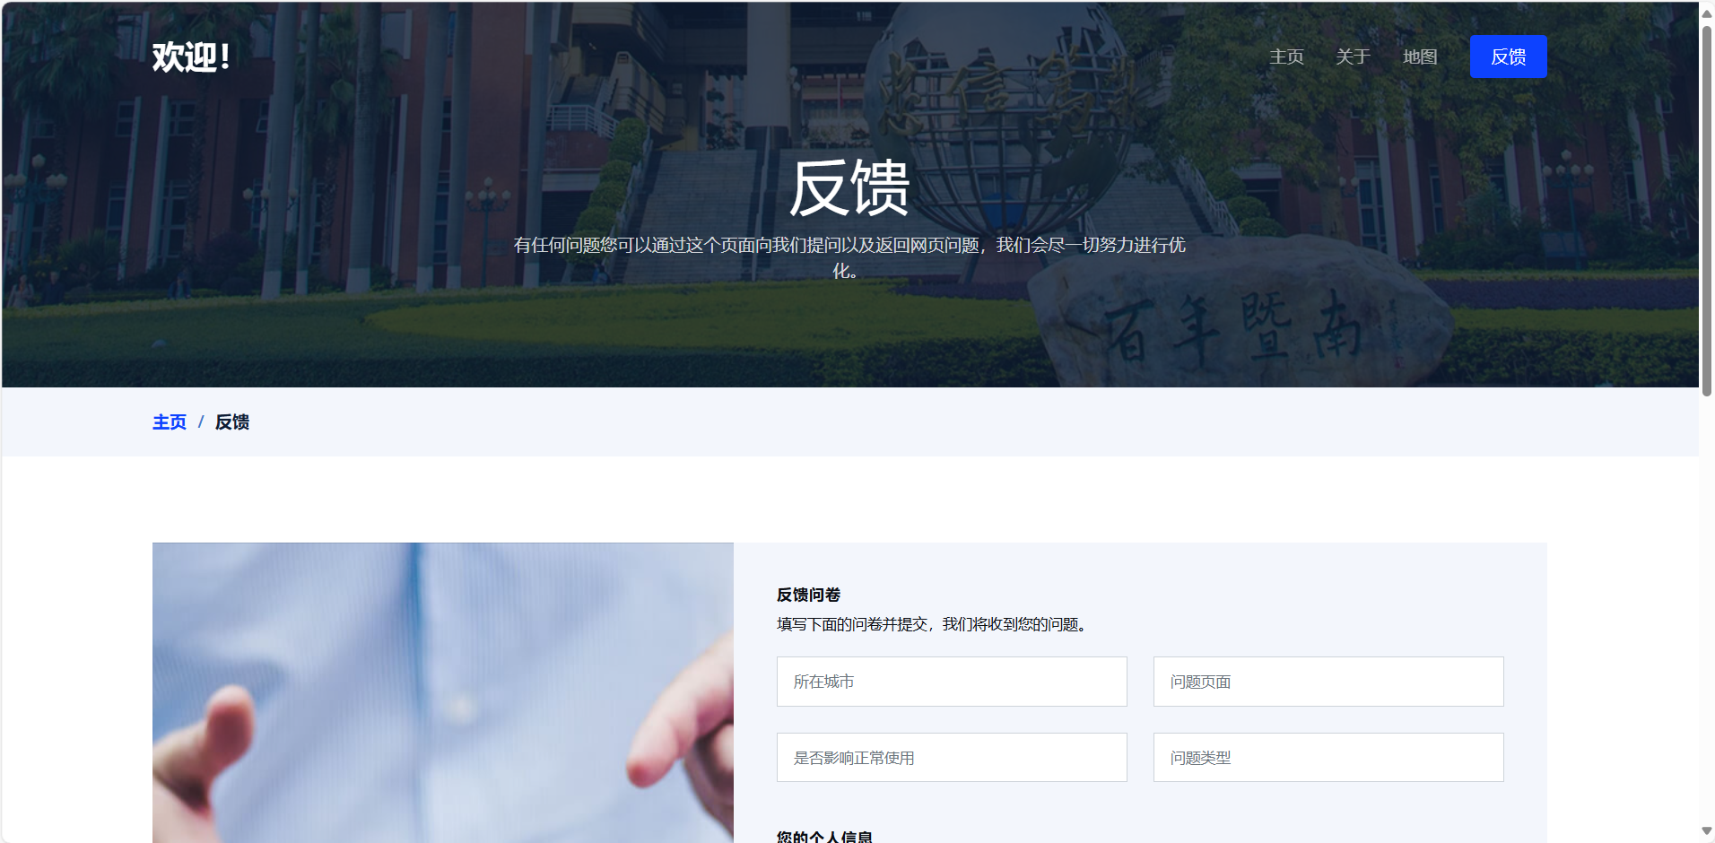
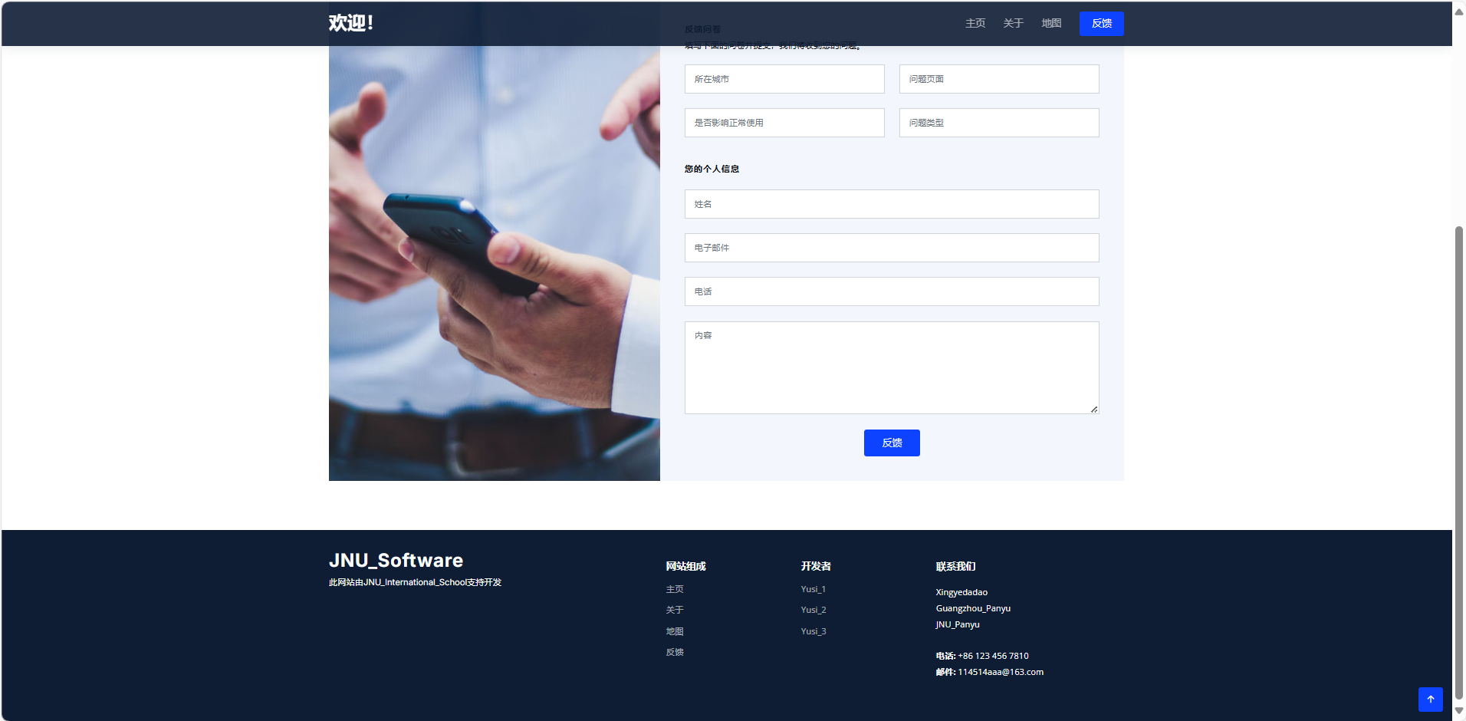
Feedback

Slide 13
05
pricing

Slide 14
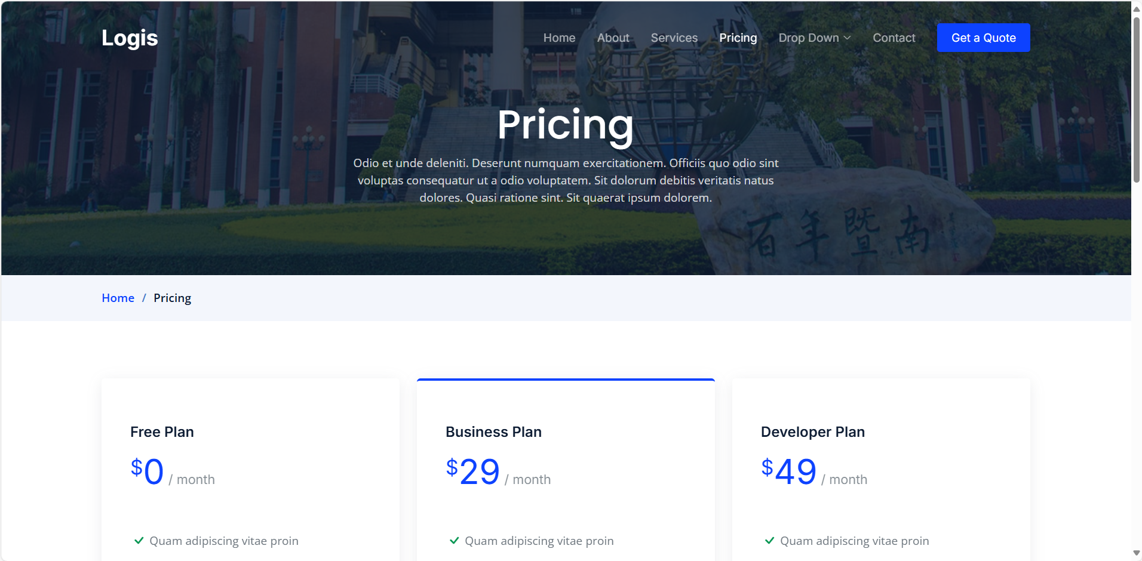
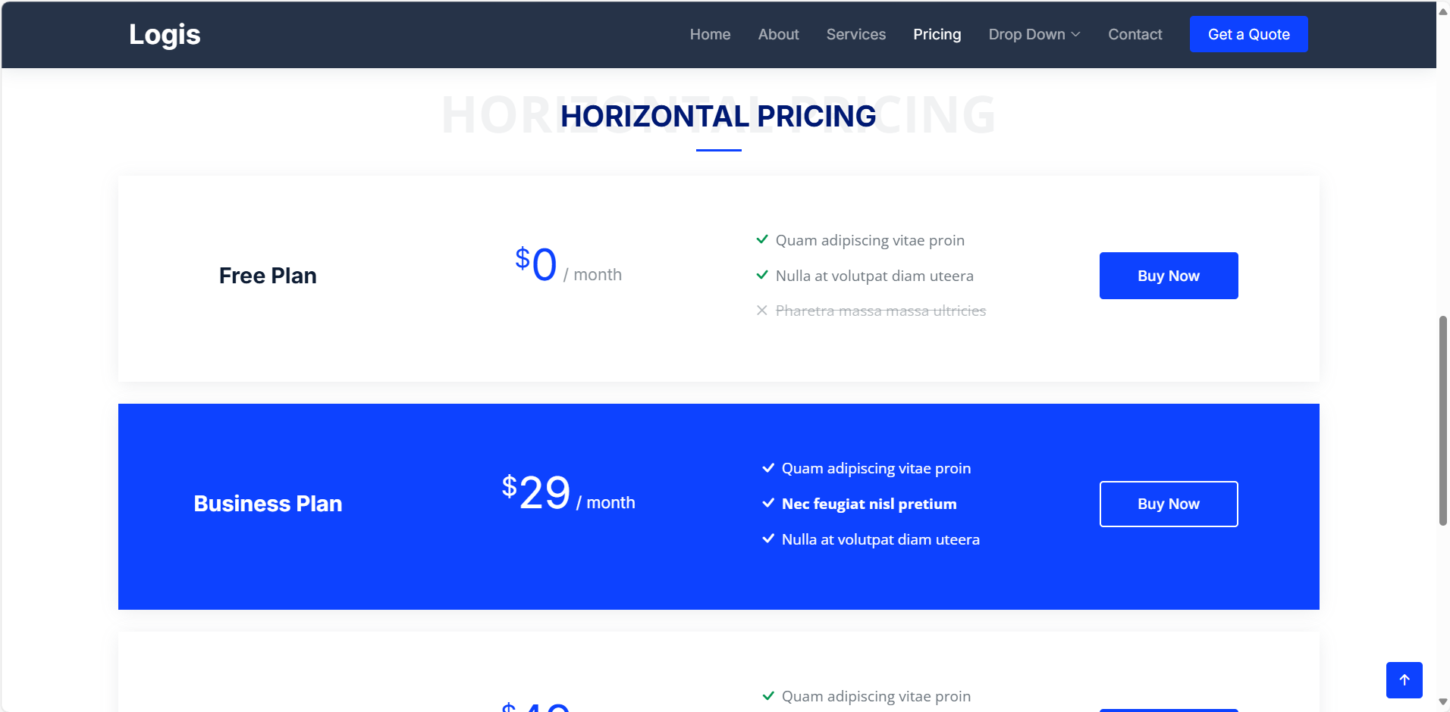
pricing

Slide 15


THANKS!
Please keep this slide for attribution

